Slide 1

Name PRN
Suyash Gaikwad 12210658
Review of Internship at Markytics.AI
A comprehensive overview of my training, projects, and personal growth during my internship at Markytics.AI
College Department Supervisor Name
Company Supervisor Name
Jyoti Yadav
Utkarsh Mukkawar

Slide 2
Introduction
Internship Overview
Training Overview
Project- SmartCollect
AI Scrub Analysis
Risk Categorization & Inquiry
Sakhi App
Technologies used
Table of Content

Slide 3


Introduction to the Company
Markytics.AI
Markytics helps businesses use AI to work smarter and connect better with customers.
We provide AI solutions that improve business processes with data, automation, and analytics.
Our focus is on efficiency, customer engagement, and growth opportunities.
With Generative AI, Predictive Analytics, and Process Automation, we deliver real results.
Enterprise AI from Markytics powers smarter decisions and better experiences.

Slide 4
Internship Overview
Full Stack Developer Django Developer React Developer
Hands-on Training in Django
Inventory Management System
Smartcollect
Reports Section
Sakhi App

Slide 5

Project : SmartCollect
SmartCollect
AI-powered debt recovery and collections platform for financial institutions to manage the entire collections lifecycle efficiently.
Core Features:
Automated Reminders – SMS, Email, WhatsApp, IVR.
Multi-Channel Communication – Engage customers on preferred
channels.
Segmented Workflows – Strategies for different customer groups.
Analytics & Dashboards – Real-time recovery insights.
System Integration – Connects with loan DB, payment gateways, client
systems.
AI-Powered Decisions – Smart timing, channel selection, escalations.

Slide 6
AI Scrub Analysis
Objective:
To classify and assess customers based on payment behavior to our bank and other
Process:
We conducted a "scrub analysis" by comparing the last payment dates of customers
to our bank's records and their credit reports from other banks.
Key Classifications:
Good with Us, Paying Others: These customers are paying us on time and are also in good standing with other lenders. This is our lowest-risk segment.
Good with Us, Not Paying Others: They are paying us but are defaulting on
payments to other lenders. This is an early warning sign of potential financial distress.
Default with Us, Paying Others: These customers are defaulting on their payments to our bank, despite paying their dues to others. This requires immediate attention and investigation.
Default with Us, Not Paying Others: This group represents our highest risk segment,
as they are defaulting on all their payments. These customers are a top priority for

Slide 7
Risk Categorization & Inquiry
Objective:
To provide a deeper, data-driven view of risk using Days Past Due (DPD) and loan inquiry
data.
DPD-Based Risk Categorization:
We categorized the customer portfolio into four risk tiers based on their DPD range.
Low Risk: DPD of 0 days (Current accounts).
Low-Medium Risk: Customers with DPD from 1 to 30 days.
Medium Risk: Customers with DPD from 31 to 90 dys.
High Risk: Customers with DPD of more than 90 days.
Loan Inquiry Analysis
We analyzed the dates and frequency of loan inquiries our customers made with other banks.

Slide 8
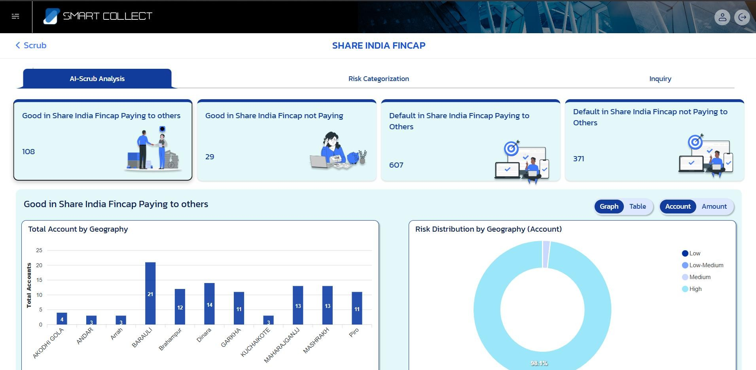
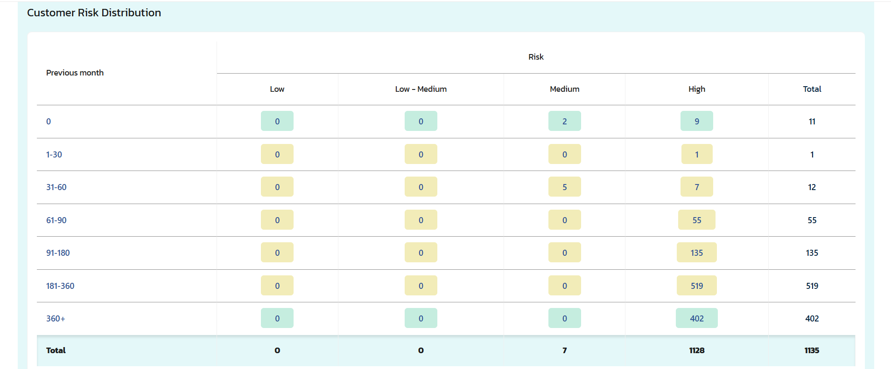
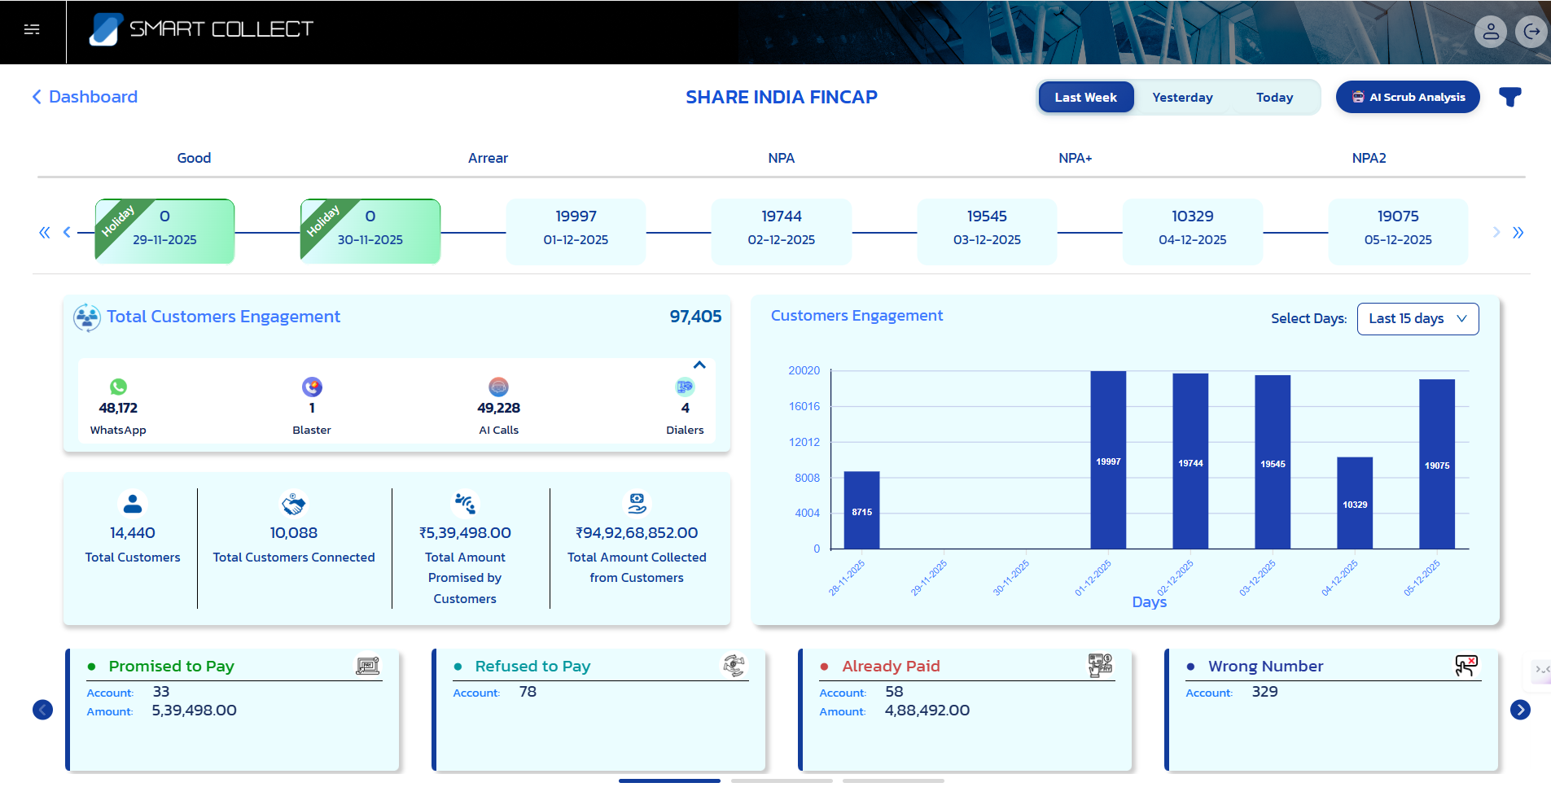
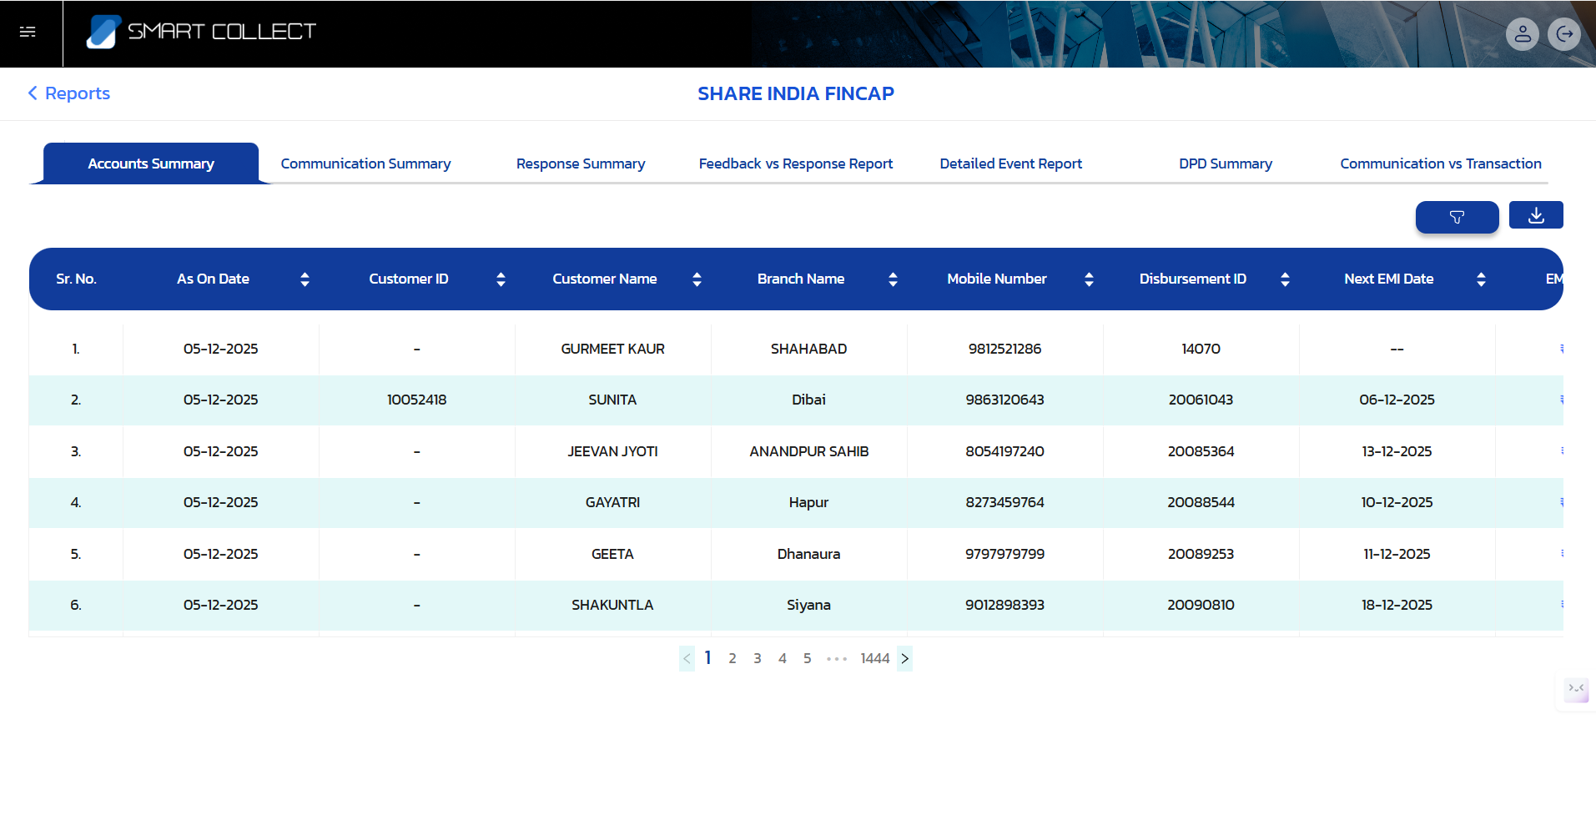
SNAPSHOTS
.

Slide 9
Sakhi App:-
The Sonata Finance App is a digital financial platform designed to help users easily manage their loans, EMIs, and financial profile from one place. The app provides borrowers with a simple and transparent way to track loan progress, make payments, view offers, and access support services. It aims to make financial management convenient for users by offering real-time updates, secure transactions, and a user-friendly interface.
.
1. EMI & Loan Management
            Display of active, closed, and pre-settlement loans
          Loan details with total amount, EMI value, due dates, and repayment percentage
          Progress bars to track payment completion
2. Home Dashboard
Total amount due and remaining EMIs
Quick service shortcuts (Benefits, Marketplace, Insurance, etc.)
Personalized loan offers
3. Help & Support Integration
Direct support call option
Complaint filing system
FAQ categories
AI-powered Sakhi Assistant chatbot for instant help
4. Profile & Settings
User profile completion tracker
Tier progress system
WhatsApp & Email verification
Language & theme settings, notifications toggle

Slide 10
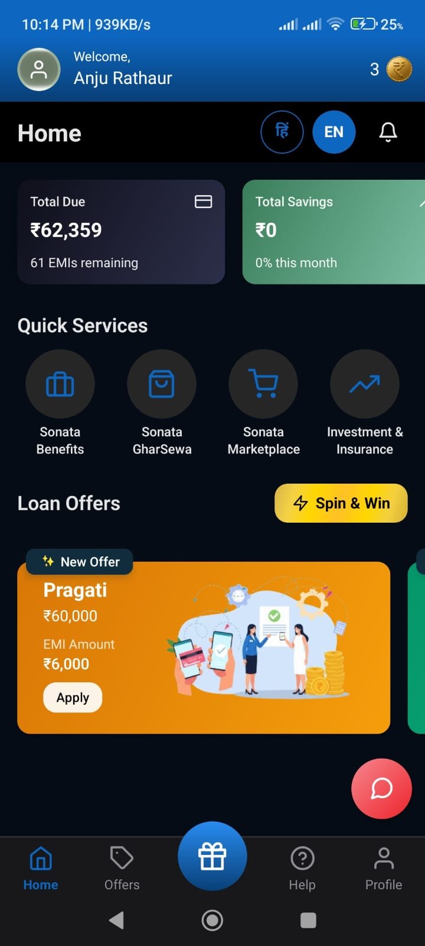
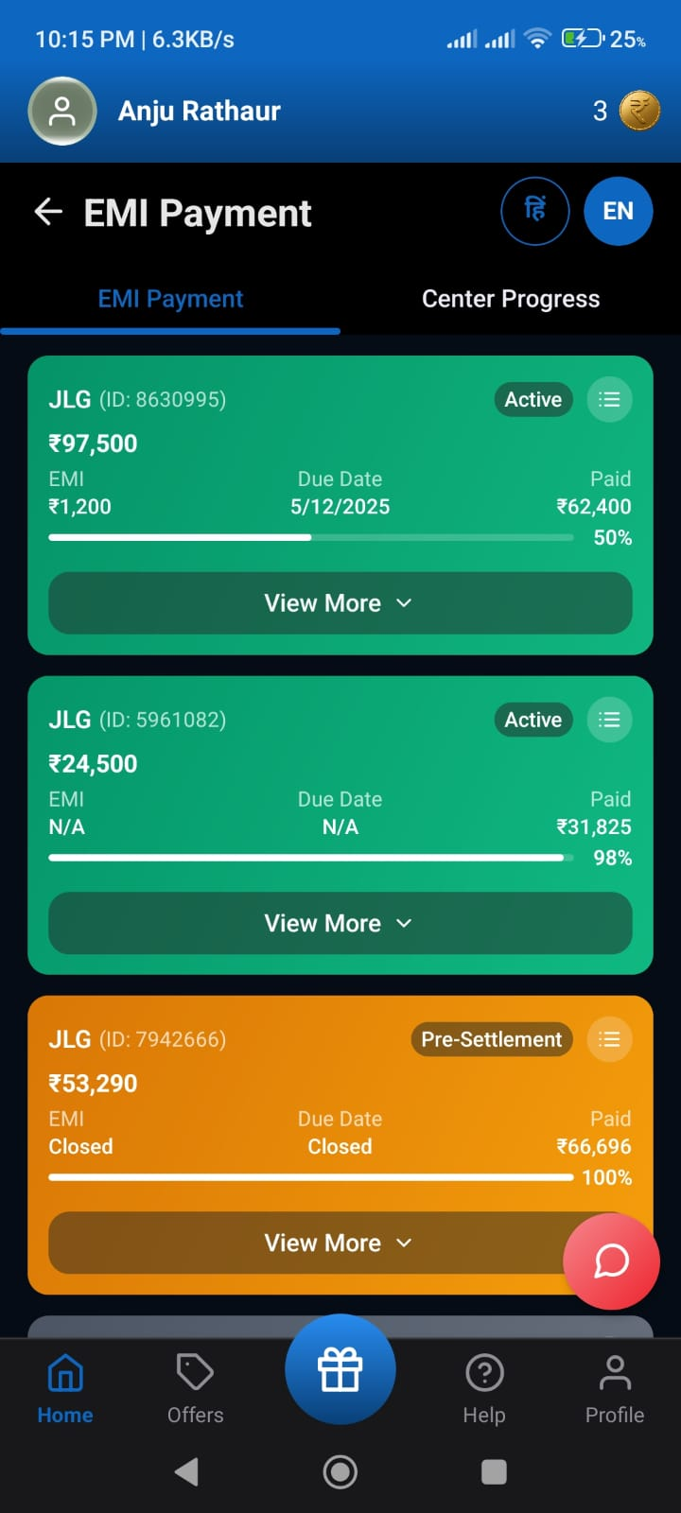
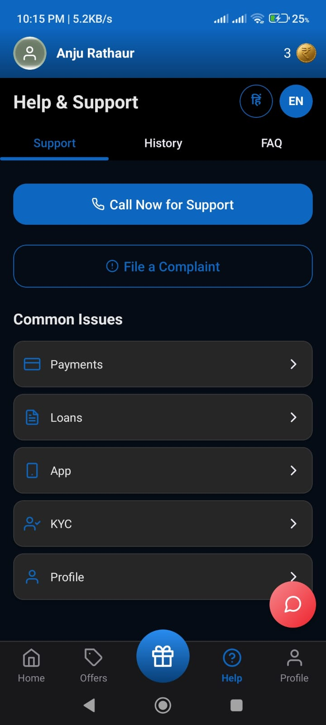
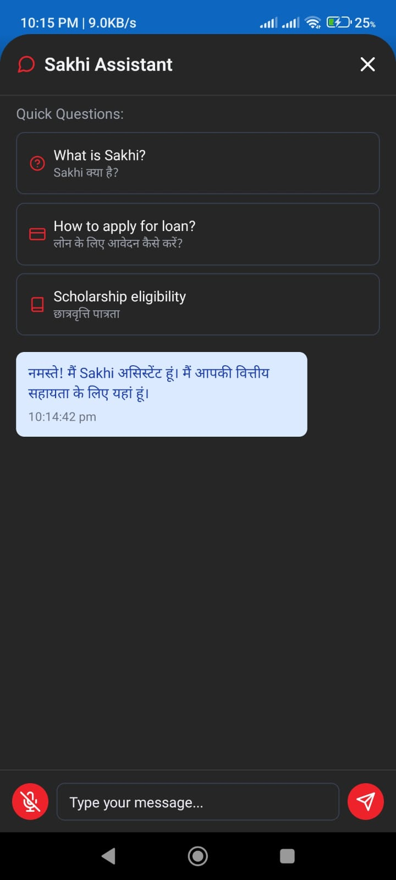
SNAPSHOTS:-
.

Slide 11











Technologies Used

Slide 12
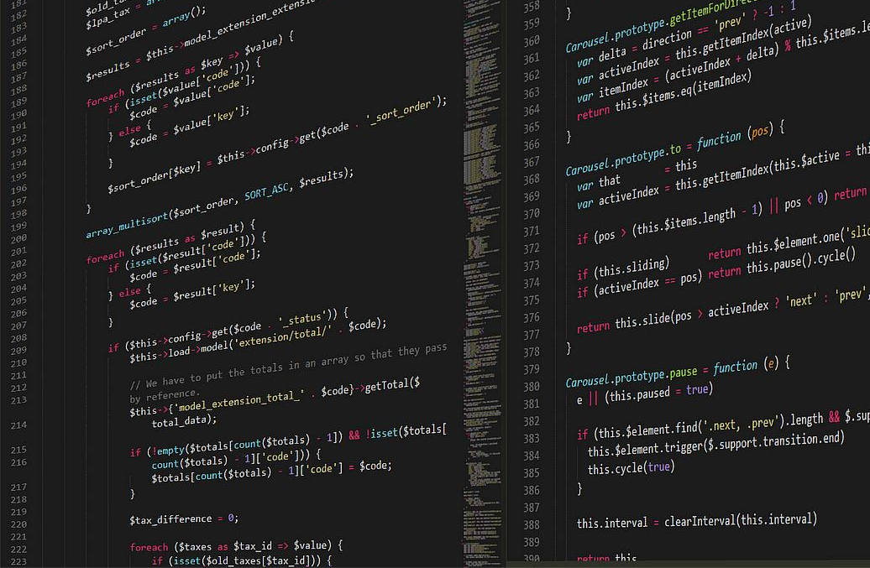
Thank You !

